Slide 1
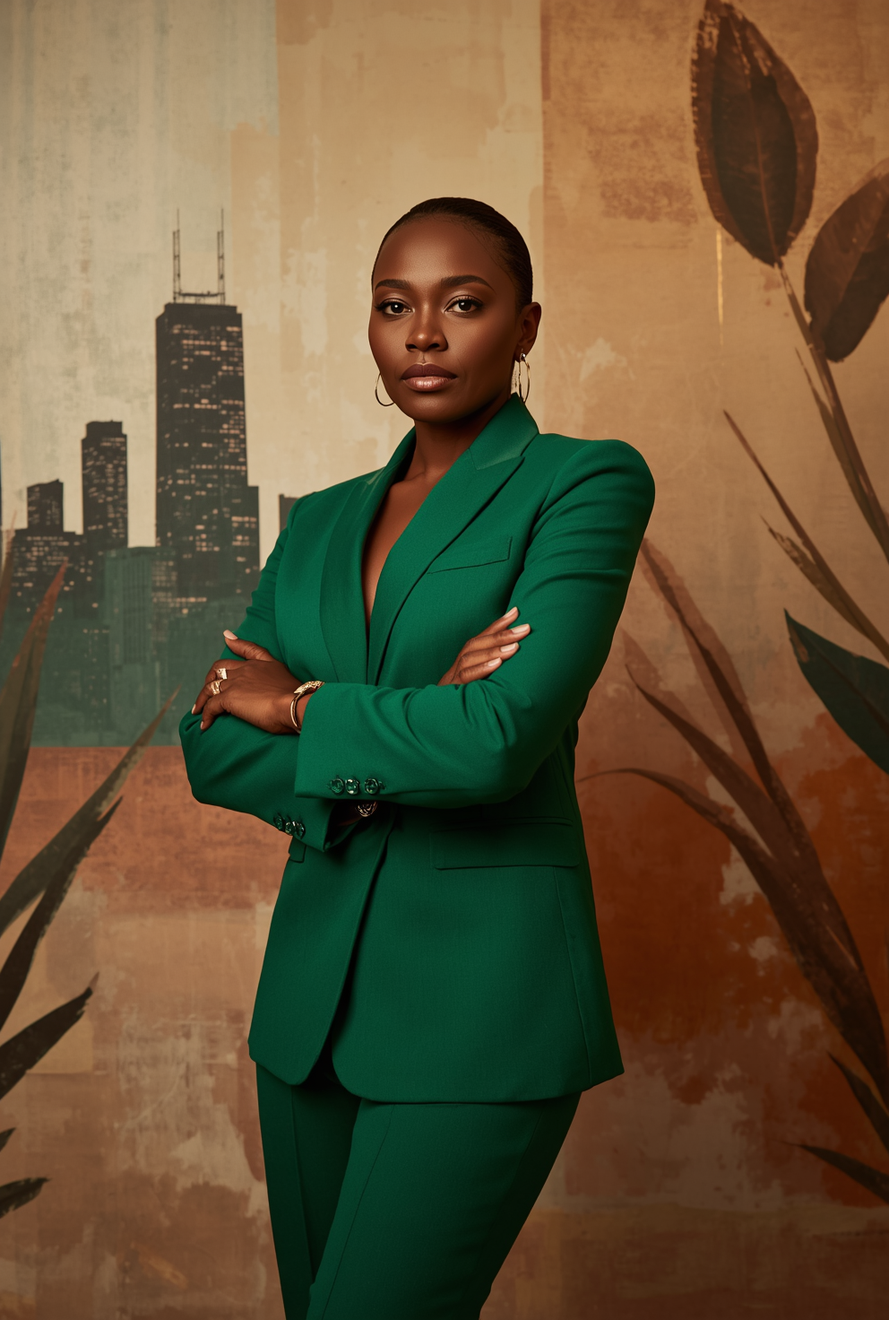
PREMIUM MEDIA KIT • 2025
Tiffany Webb,
BBA, MHP
Bold & Brilliant | Chicago Soul | Louisiana Heart
PUBLIC HEALTH LEADER • SPEAKER • STRATEGIST
Notes:
Our focus today is on Tiffany Webb's Premium Media Kit for 2025. Let’s dive into what makes Tiffany an exceptional public health leader, speaker, and strategist.
First, take a moment to appreciate her credentials: a BBA and a Master’s in Public Health. These qualifications are the foundation of her expertise.
[Pause for a moment to let the audience absorb this information.]
Tiffany’s approach is captured beautifully in her tagline: "Bold & Brilliant | Chicago Soul | Louisiana Heart." These words reflect her dynamic personality and the rich cultural influences that shape her work.
[Emphasize the tagline with a slight pause before and after.]
As a leader in public health, Tiffany blends her strategic mindset with her passion for community service. Her work is not just about addressing health issues but about transforming them into empowering dialogues and actionable strategies.
[Conclude with a confident tone to highlight her leadership and impact.]

Slide 2
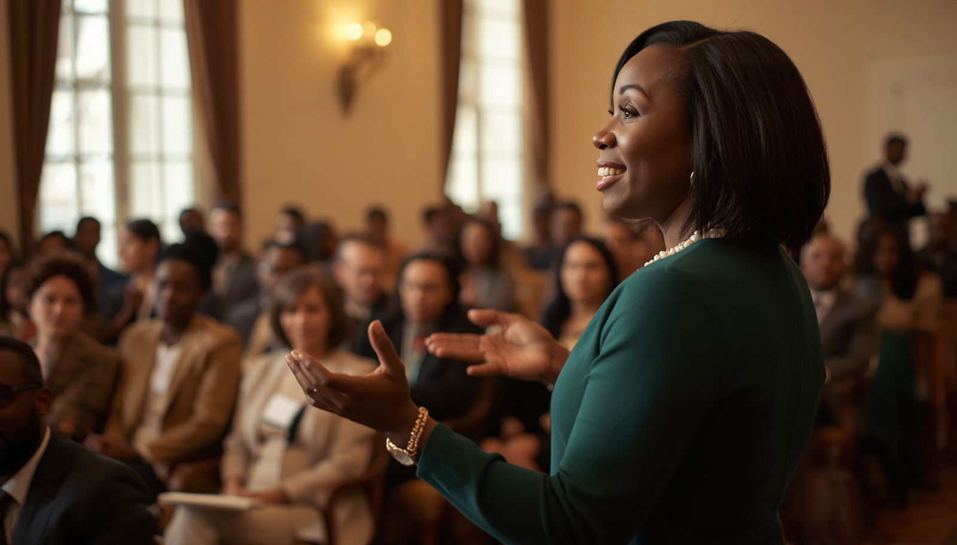
01 / THE STORY
Meet
Tiffany Webb
Rooted in Chicago and shaped by Louisiana heritage, Tiffany brings cultural intelligence, public health leadership, and an unwavering commitment to service. Her work turns complex challenges into conversations communities can trust—and strategies they can use.
“Prevention begins with conversation and relationships.”
02
Notes:
Let’s dive into Tiffany Webb’s story—a journey shaped by the vibrant cultures of Chicago and Louisiana. This unique combination gives Tiffany a robust cultural intelligence and a deep commitment to public health leadership.
[Pause for a moment to let the audience absorb.]
Tiffany’s work is all about transforming complex challenges into trustworthy conversations. She’s not just focused on creating strategies; she emphasizes making these strategies accessible and actionable for communities.
[Emphasize the next quote by pausing before and after.]
As Tiffany often says, “Prevention begins with conversation and relationships.” This philosophy highlights the importance of dialogue and connection in driving meaningful change.
[Make eye contact with the audience to engage them.]
By understanding the roots and motivations behind her work, we can appreciate how her background and beliefs fuel her dedication to service and leadership. This sets the stage for exploring her mission and purpose, which we’ll cover next.

Slide 3
MISSION & PURPOSE
Leadership with
heart and strategy.
Tiffany advances healthier communities through education, prevention, service, and meaningful partnership. She pairs evidence with empathy—building solutions with people, not simply for them.
Hope grows where people feel seen, heard, and connected.
03
Notes:
[Pause for a moment to let the slide title resonate: "MISSION & PURPOSE"]
As we move forward, let's delve into what truly drives Tiffany's work.
Her leadership is a unique blend of heart and strategy. Tiffany is committed to advancing healthier communities, and she achieves this through education, prevention, service, and forming meaningful partnerships. This approach is not just about implementing evidence-based strategies, but about coupling that evidence with empathy.
[Emphasize the following point]
By creating solutions with people, rather than just for them, Tiffany ensures that hope flourishes in places where individuals feel seen, heard, and connected. This is what makes her approach so impactful.
[Conclude with a reflective pause before transitioning]
Remember, hope grows where there is connection and understanding. Let's explore how her expertise continues to influence and inspire.

Slide 4

PROFESSIONAL EXPERTISE
Expertise that
moves people.
01
Public Health Leadership
02
Community Engagement & Education
03
Prevention Strategies & Policy
04
Strategic Communication & Advocacy
04
Notes:
Today, we're diving into Tiffany Webb's professional expertise—an impressive blend of skills that truly moves people.
[Pause for a moment to let the audience absorb the title.]
Firstly, let's talk about Public Health Leadership. Tiffany's approach here is both innovative and grounded in real-world experience, allowing her to guide communities through complex health landscapes with clarity and confidence.
Next, we have Community Engagement & Education. Tiffany excels in creating spaces where learning and connection flourish. Her ability to engage diverse groups ensures that everyone feels included and empowered to participate in meaningful dialogue.
[Pause for emphasis on engagement.]
Then, there's Prevention Strategies & Policy. Her expertise in crafting forward-thinking strategies helps communities not only anticipate challenges but also proactively address them, resulting in sustainable health outcomes.
Finally, Strategic Communication & Advocacy. Tiffany’s communication is strategic and impactful, driving advocacy efforts that bring about real change.
[Conclude with a smile and a nod.]
Each of these areas not only defines Tiffany's professional journey but also underscores her commitment to building healthier, more connected communities.

Slide 5
SIGNATURE SPEAKING TOPICS
Conversations
that create change.
Community-Driven Prevention
Public Health Equity & Access
Leadership in Complex Systems
Building Resilient Communities
Navigating Difficult Conversations
05
Notes:
Today, we'll explore the impactful signature speaking topics that Tiffany is renowned for. These are conversations designed to ignite change and inspire action.
First, Community-Driven Prevention focuses on empowering local communities to take charge of their health initiatives. It's about understanding their unique needs and fostering solutions that are sustainable and effective. [Pause briefly here for emphasis]
Next, we'll delve into Public Health Equity & Access, which is crucial in ensuring that every individual, regardless of their background, has the opportunity to achieve optimal health. This topic emphasizes the breaking down of barriers and promoting inclusivity in healthcare systems. [Lean forward slightly to engage the audience]
We'll also cover Leadership in Complex Systems, a vital skill in navigating the intricate networks of public health and community services. Here, Tiffany shares strategies for effective leadership that drives innovation and collaboration.
Additionally, Building Resilient Communities is about fortifying communities to withstand and thrive amidst challenges. This involves fostering strong networks and support systems.
Finally, Navigating Difficult Conversations equips audiences with the tools to handle sensitive discussions constructively, ensuring that every voice is heard and valued. [Pause and smile to connect with the audience]
Each of these topics is crafted to inspire leaders and advocates to take meaningful action in their communities.

Slide 6

AUDIENCES SERVED
Built for
shared progress.
Nonprofit Leaders & Healthcare Professionals
Community Organizations & Advocates
Educational Institutions & Students
Government & Policy Makers
Corporate Social Responsibility Teams
06
Notes:
As we move into discussing the diverse audiences we serve, it's important to recognize the breadth of our reach and the value of our collaborative efforts. [Pause to engage audience]
Firstly, we cater to nonprofit leaders and healthcare professionals, who are at the forefront of making impactful changes in their communities. These individuals are often navigating limited resources, yet their dedication ensures that vital services reach those in need.
Next, community organizations and advocates play a critical role. Their grassroots efforts are key to fostering sustainable change, and by partnering with them, we amplify our shared mission for progress.
Educational institutions and students are also pivotal. By investing in education, we prepare the next generation of leaders, equipping them with the knowledge to drive future innovations in public health and community well-being.
We also engage with government and policymakers. Their support is essential for implementing large-scale initiatives and policies that can bring about systemic change.
Finally, corporate social responsibility teams are increasingly recognizing their role in contributing to societal wellbeing. Their involvement helps bridge the gap between corporate interests and community needs, promoting a more inclusive approach to business.
[Emphasize and pause for effect]
Together, these audiences form a powerful network united by a shared vision of progress. As we continue, we'll explore some of the career highlights and services that have shaped our journey in this mission.

Slide 7
SELECTED CAREER HIGHLIGHTS
A career built
on public trust.
Leadership roles across major public health initiatives
Recognition for service and community impact
Signature prevention programs launched
Media appearances and keynote conversations
07
Notes:
Today, I am excited to share with you some of the key highlights from my career, a journey deeply rooted in public trust.
First, let's talk about my leadership roles. [Pause, make eye contact with the audience.] I have been privileged to lead several major public health initiatives, which have not only shaped policies but also fostered healthier communities.
Next, recognition for service and community impact. [Emphasize with a slight nod.] Throughout my career, I've been honored for my contributions to community welfare, a testament to our collective efforts in enhancing public health.
And finally, signature prevention programs. These initiatives, which I've had the opportunity to launch, have been pivotal in preventing health crises and promoting wellness across diverse populations.
[Pause briefly to let the information sink in.]
Additionally, my presence in media and keynote conversations has allowed me to share insights and foster dialogue on pressing public health issues, further extending our reach and impact.
[Conclude with a warm smile and a nod.] Thank you for joining me on this journey. Let's continue to build on these successes as we explore more ways to collaborate.

Slide 8
SERVICES
Ways to work
together.
Keynote Speaking & Panel Moderation
Strategic Consulting & Training
Clear, memorable conversations that move a room.
Practical guidance for leaders navigating complexity.
Media & Public Relations Support
Community Outreach Program Design
Credible messaging grounded in community insight.
Human-centered programs built for participation.
08
Notes:
When discussing the services we offer, it's important to convey the impact and value we bring to our partners.
Starting with Keynote Speaking & Panel Moderation, emphasize how our approach creates impactful and memorable experiences. We don't just speak; we aim to move the room and inspire action.
[Pause here to let the audience envision impactful conversations.]
Next, with Strategic Consulting & Training, highlight our ability to provide practical guidance to leaders. We understand the complexities they face and offer solutions that are both effective and actionable.
[Use a confident tone to emphasize the practical benefits offered.]
For Media & Public Relations Support, stress our commitment to delivering credible messaging. We leverage community insights to ensure our communications resonate and build trust.
Finally, in Community Outreach Program Design, we focus on creating human-centered programs that encourage active participation. Our goal is to design outreach efforts that are inclusive and engaging.
[Conclude with a smile, inviting questions or expressions of interest.]

Slide 9
EVENTS & STRATEGIC PARTNERSHIPS
High-impact presence.
Purposeful partnership.
Tiffany brings a community-first lens to conferences, nonprofit convenings, institutional programs, and cross-sector collaborations—helping partners turn visibility into lasting value.
CONFERENCES
NONPROFITS
PUBLIC INSTITUTIONS
09
Notes:
When discussing "Events & Strategic Partnerships," focus on the transformative impact Tiffany has within these collaborations. Highlight her unique ability to turn visibility into lasting value by approaching each partnership with a community-first perspective.
Start by emphasizing her high-impact presence in conferences, nonprofit convenings, institutional programs, and cross-sector collaborations. Explain how this presence is not just about being visible, but about creating meaningful engagement that benefits all parties involved.
[Tiffany brings a community-first lens to all her initiatives, ensuring that the partnerships she forms are both impactful and sustainable.]
Next, mention the diverse range of sectors where she is involved, such as conferences, nonprofits, and public institutions. This diversity showcases her adaptability and broad influence across different domains.
[This diversity demonstrates her adaptability and broad influence across different sectors.]
Conclude by reinforcing the idea that through her strategic partnerships, Tiffany helps her partners achieve not just immediate visibility but also long-term value and impact.
[Conclude with a strong emphasis on the longevity and sustainability of the value she creates.]

Slide 10
WHY ORGANIZATIONS CHOOSE TIFFANY
Credibility you can feel.
01
02
03
04
Authentic Connection & Trust Building
Deep Community Insight & Cultural Competence
Expert Knowledge with Practical Solutions
Warm, Engaging & Confident Delivery
10
Notes:
Today, we're diving into why organizations consistently choose to collaborate with Tiffany.
Firstly, it's about credibility you can feel. Tiffany doesn't just talk the talk; she walks the walk by building authentic connections that foster trust. This is crucial in any partnership, as trust is the foundation of successful collaboration.
[Pause for emphasis]
Next, Tiffany brings deep community insight and cultural competence. Her ability to understand and respect diverse perspectives ensures that her solutions are not only effective but also respectful and inclusive of all stakeholders.
[Pause to let this point resonate]
Tiffany marries her expert knowledge with practical solutions. Her strategic approach transforms complex challenges into manageable actions, making a real impact.
Lastly, her warm, engaging, and confident delivery makes every interaction memorable. Tiffany ensures that her audience not only understands the message but also feels inspired and motivated to act.
[Conclude with a confident tone]
These are the qualities that set Tiffany apart and make her the preferred choice for organizations seeking genuine, impactful partnerships.

Slide 11
ORGANIZATIONS & PARTNERSHIPS
Trusted by leading organizations
and communities.
HEALTH SYSTEMS
COMMUNITY ORGANIZATIONS
EDUCATION
PUBLIC SECTOR
NONPROFIT NETWORKS
MEDIA & EVENTS
11
Notes:
In this slide, we're focusing on the diverse range of organizations and partnerships that trust Tiffany's expertise and commitment.
[Tone: Confident and inclusive]
Tiffany collaborates with a variety of sectors, including health systems, community organizations, and educational institutions. Her influence extends to the public sector and nonprofit networks, demonstrating her adaptability and comprehensive approach to partnership building.
[Pause here to allow the audience to absorb the breadth of her collaborations]
What sets Tiffany apart is her ability to bridge gaps across different sectors—whether it's media and events or grassroots community groups. This wide-reaching trust is a testament to her credibility and the impactful results she consistently delivers.
[Conclude with a welcoming gesture to emphasize inclusivity]

Slide 12

MEDIA RESOURCES
Ready for
the room—and
the story.
High-resolution photos & headshots
Speaker bios & talking points
Video clips & past speaking engagements
12
Notes:
In this slide, we're focusing on the media resources available for promoting Tiffany's speaking engagements. [Pause for a moment to let the audience absorb the slide title.]
First, highlight the availability of high-resolution photos and headshots. These are essential for event promotions and can be used in various media outlets. [Pause briefly for impact.]
Next, mention the comprehensive speaker bios and talking points. These resources ensure that media and event organizers have all the necessary information to effectively introduce Tiffany and convey her key messages. [Emphasize "effectively introduce."]
Finally, draw attention to the video clips and past speaking engagements. These are valuable tools that showcase Tiffany's dynamic speaking style and the impact she has had in previous events. [Pause to let this point resonate.]
With these resources, Tiffany is well-prepared to make a lasting impression in any media setting.

Slide 13
“
Hear what others say
about Tiffany’s impact.
TESTIMONIALS • PLACEHOLDER
13
Notes:
For this slide, we want to emphasize the powerful impact that Tiffany has had, as shared by others who have experienced her work firsthand.
Begin by setting the stage with enthusiasm: “Now, let’s dive into some real stories about Tiffany’s impact.” [Pause to let the audience anticipate.]
Highlight that testimonials provide genuine insights and reflect the positive changes Tiffany has fostered. Encourage your audience to listen for the heartfelt experiences and successes shared by others. [Pause briefly after each testimonial to let the impact sink in.]
Wrap up by inviting the audience to consider how they might also benefit from Tiffany’s influence, setting a positive tone for the next slide about contact and booking.
[Conclude with a confident smile.]

Slide 14

CONTACT & BOOKING
Let’s Create
Impact Together
Booking inquiries: Tiffanywebb89@yahoo.com
Website: tiffanywebbimpact.com
Social: @Tiffanywebb.Impact
CHICAGO Heart • LOUISIANA Soul
14
Notes:
As we wrap up this presentation, let's focus on how you can connect with me and become part of the impactful journey we're creating together.
First, for any booking inquiries, you can reach me directly at my email: Tiffanywebb89@yahoo.com. I'm always thrilled to discuss potential collaborations and opportunities to make a difference.
[Pause briefly to emphasize the points]
Next, my website, tiffanywebbimpact.com, is your go-to resource for all things related to my work. Whether you're looking for more information or want to explore the various projects I've been involved in, it's all there for you.
And of course, don't forget to follow me on social media at @Tiffanywebb.Impact. It's a great way to stay updated on my latest activities and insights.
[Smile and maintain eye contact with the audience]
Remember, my work is fueled by the vibrant spirit of a Chicago heart and the soulful warmth of Louisiana. Together, let's create meaningful impact and drive positive change.
[Conclude with enthusiasm and a gesture of openness]

